Slide 1
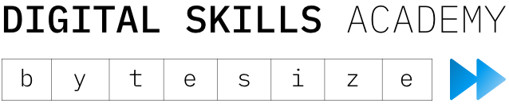
Introduction to Frontend Web Development
April 2020

Slide 2
How does the DSA work?
Student cohort
DSA Classroom Training
4 WEEKS
Apply learning
4 WEEKS
Return to sponsoring business
IBM & client grads, interns, apprentices
Technical skills
Client
Innovation Project
Professional skills
DSA Case Study
Client Presentation

Slide 3
DSA Bytesize
1-2 day sessions based on the most popular DSA modules
No technical experience needed!
Focus on hands-on labs rather than hours of lectures

Slide 4
Course Content
Day 1
Introduction to HTML
Introduction to CSS
Styling pages with CSS Grid
Day 2
Introduction to JavaScript
Making API calls & functional webpages
Finish project
Each topic will have a brief introduction and explanation, then a small set of challenges
Mentors will be available to answer any coding questions you may have – please ask

Slide 5
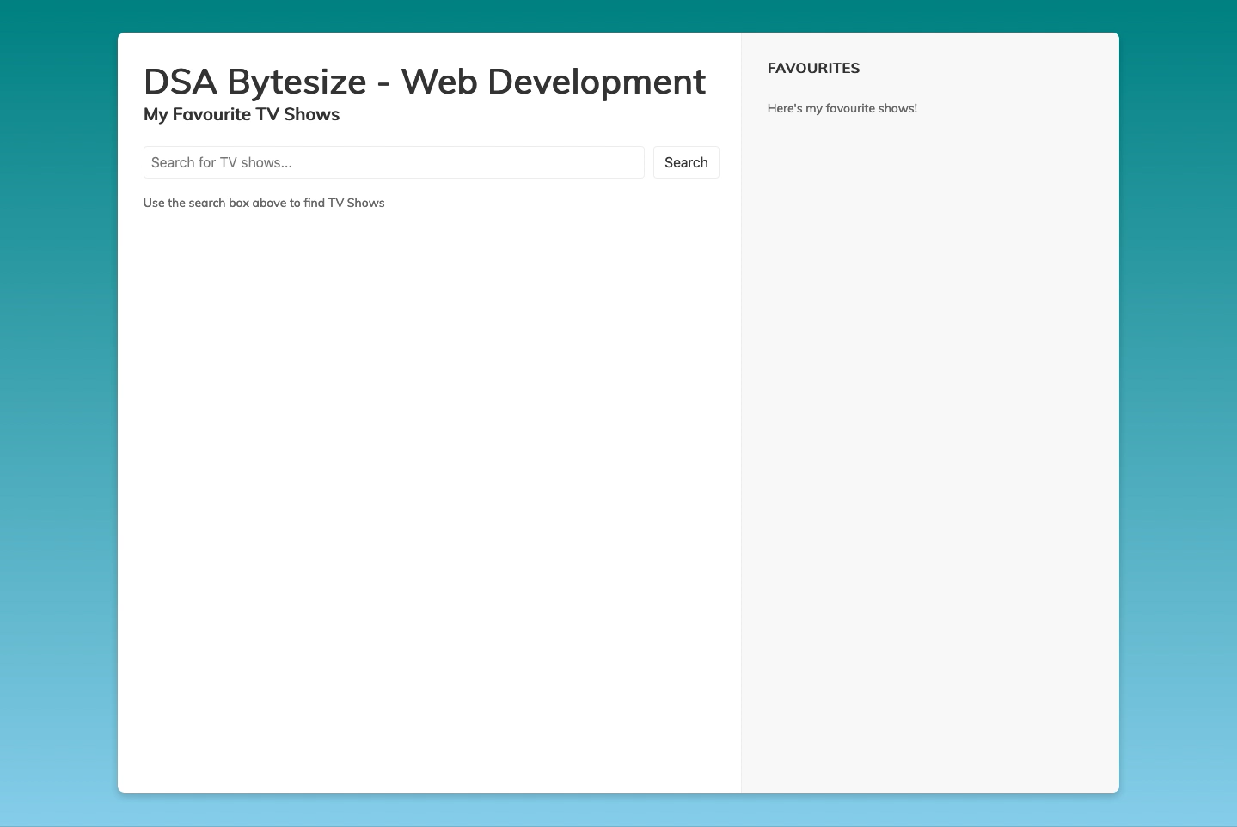

Slide 6
Icebreaker
Introduce yourself (turn your camera on if it’s not already)
Tell us which one item you’d bring if you were stranded on a desert island
Show us the most interesting item within reach of your current seat
Handover to the person on the left of your webex window
Notes:
Mention the boring bits… but bear with
Anyone on win7?

Slide 7
How we teach
We’ll introduce each topic first with a short talk
We’ll then switch over to coding some basic examples, via a screen-share. You should follow along at the same time – we’ll go at a pace that everyone can follow

Slide 8
How we teach
We’ll then set a challenge (or series of challenges). We won’t tell you exactly how to complete them, but you should have enough hints to get started.
We’ll also give links to helpful websites at the start of each challenge.
If you get stuck, ask for help! We’ll either explain to everyone on the main WebEx, or one of the team will go on a private slack call with you to assist.
At regular intervals throughout the day, we’ll explain the next steps and release the next challenges. If you haven’t finished, carry on with your current work – the process of learning is more important than the outcome!
Check slack for polls too!
Notes:
Complete challenges in your own time
Try first, then ask for help, don’t be afraid, we’ve all done dumb stuff
Please don’t do project work
No rush – doesn’t matter if you don’t finish

Slide 9
Break
Please install Visual Studio Code (VSCode) if you haven’t already

Slide 10
Introduction to HTML
Defines the meaning and structure of web content
Built using pairs of matching tags, nested, e.g.
<body>
<p>This is some text</p>
<h1>This is a title</h1>
</body>

Slide 11
Challenges link
ibm.biz/dsa-bytesize-web-dev

Slide 12
Introduction to HTML - Challenge
Create a HTML page with some elements on it:
(At least) 2 sizes of headers
Some paragraph text
An input box, with a button that says “search”
An unordered list with some items in it

Slide 13
Introduction to CSS
Describes the presentation of HTML pages using specific syntax
Can vary colour, size, layout, structure, animations and more
E.g.
p {
background-color: red;
Color: white;
font-family: verdana; font-size: 20px;
}

Slide 14
Introduction to CSS - Challenge
Style your page, using the following guides:
The page should have a new font
The Headers should have a different font size
Each different section should have a different background colour
The title should be centered on the page
Clicking on one element (could be anything) takes you to another webpage (e.g. google.com)
The background of the page should either be an image (any image), or a colour gradient.
Using the browser inspector, inspect and modify an element on the fly (change a colour or something)

Slide 15

Introduction to CSS Grid
CSS Grid is a unified way of structuring HTML elements using CSS
It’s a de-facto standard, support by all modern browsers
Allows developers to create a set of rows and columns, and place content inside
They can be customized very heavily, you can even create layouts like this ->

Slide 16
CSS Grid - Challenge
Add some more classes to change the colour of each section
Make the grid bigger!
If this is too easy, then take a look at grid-template-areas and try and make a grid look something like this →
https://tinyurl.com/GridTemplateAreas

Slide 17
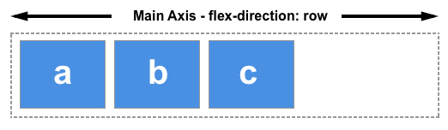
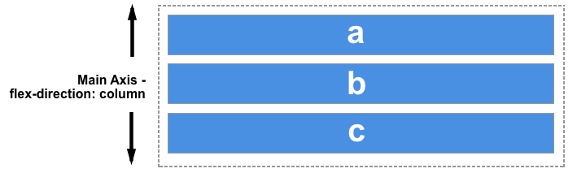
Introduction to CSS FlexBox
CSS FlexBox (known as Flex), is another way to structure webpages, slightly differently to grids
It’s also a de-facto standard, support by all modern browsers
Allows developers to structure HTML elements in a single column or row
They’re a lot simpler to create than grids, but are just as important!

Slide 18
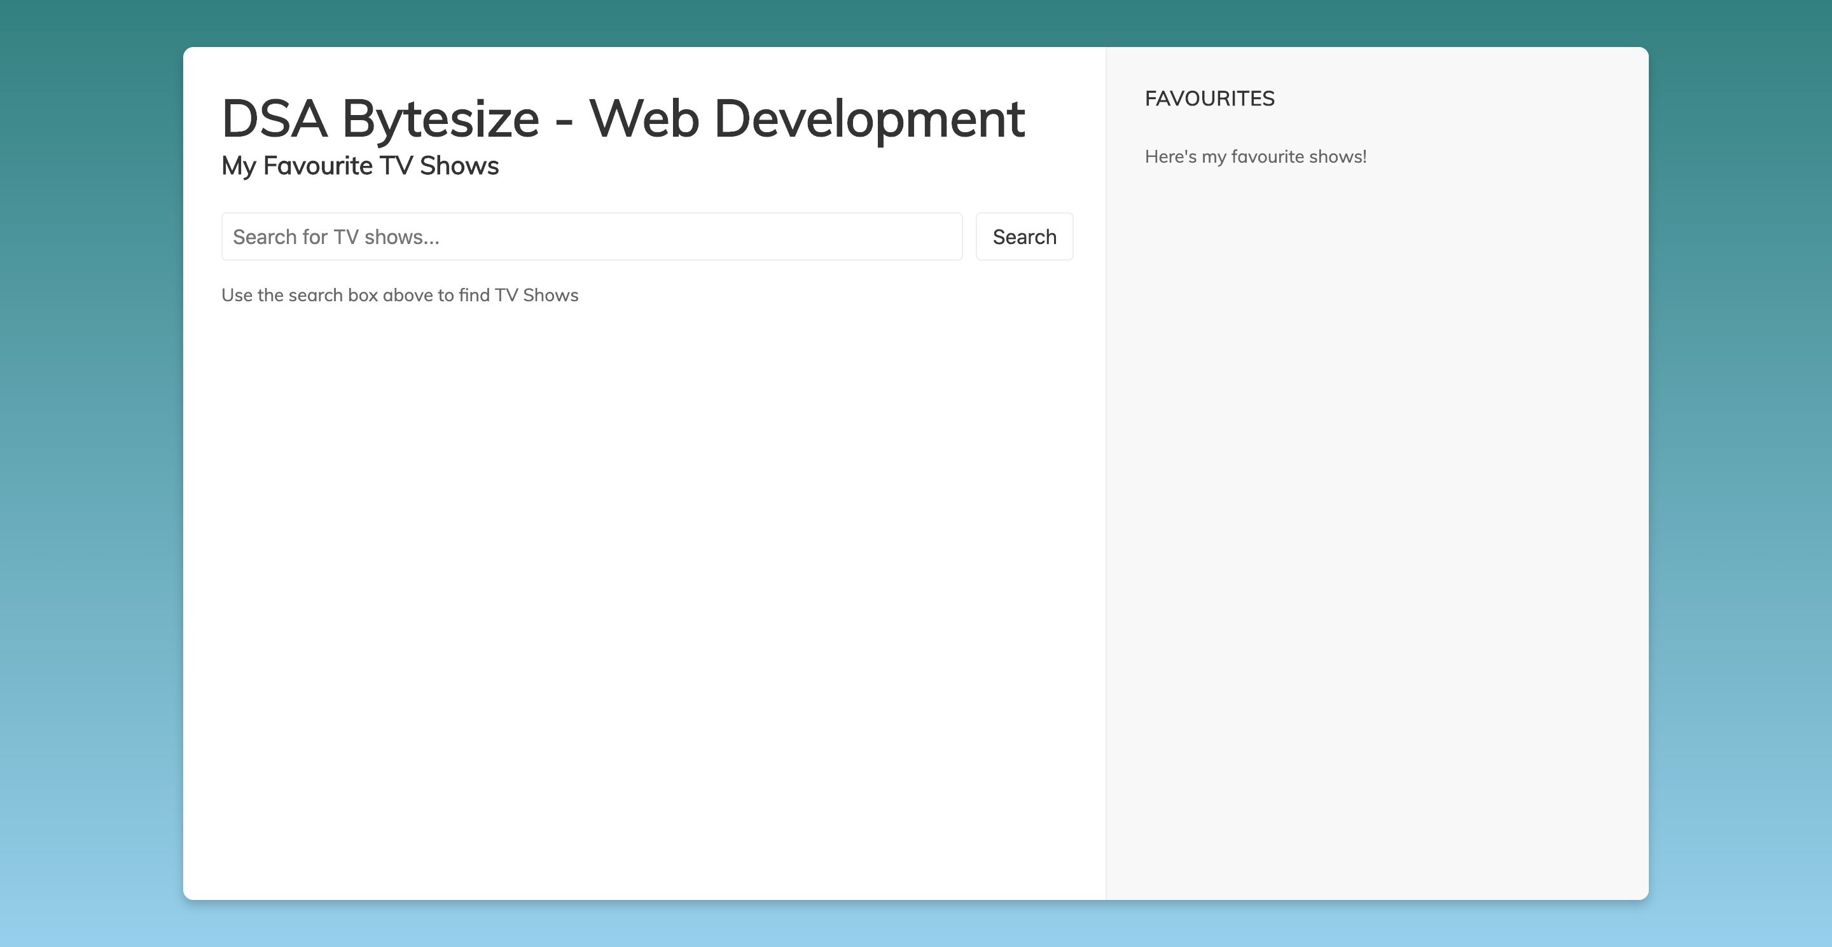
CSS Flex - Challenge
Using what you've learnt so far about CSS Grid and Flex, make your webpage look like this http://my-tv-favourites.eu-gb.mybluemix.net/
Don't worry about any of the functionality yet, we just want to make it look pretty!
This will take a bit of time, so please ask any of us for a hand :)

Slide 19
Introduction to JavaScript
JavaScript is the web’s programming language – allowing webpage to be dynamic, interactive, programmatic, and exciting
It allows you to manipulate HTML & CSS programmatically, alongside other functionality

Slide 20
JavaScript Challenges
Look on the GitHub repo!

Slide 21
How to go further with JavaScript
JavaScript can do more than just loops and storing variables
We can also use it to interact with the page directly through the DOM, as well as other APIs and more
This next section will cover how to make your page truly interactive

Slide 22
How to go further with JavaScript
Include some javaScript directly onto your html page. Make it `console.log()` the word "test".
Make an alert box pop up when you open the webpage. Customise the message.
Make an alert box pop up when you press a button.
Make an element appear on the page when you press a button
Create the following user story:
Users can enter a TV show and press search. When they do, they will see their query added to a list underneath.
Use the `await` syntax to make an API call to the TVMaze API. Hard-code the query to be your favourite TV show. Use a `console.log` to simply print out the results.
Create the following user story:
Users can search for a TV show, and be shown a list of matching responses as a list on the page below.
Create the following user story:
Users can search for a TV show, and be shown a list of matching responses as a list on the page below. Pressing the star (or similar) icon will add the show to a different list of their favourites.

Slide 23
JavaScript Frameworks
Started off with JQuery and similar, as “helper” libraries for common functions
Moved into full-scale architectures, with specific paradigms and methods, through companies such as Google and Facebook
Some common frameworks are React, VueJS, AngularJS
Stick to the basics to start with – although frameworks are invaluable for creating Single Page Applications and Web Applications
Most of these frameworks focus on the following:
Handling DOM interactions for you
Managing State properly
Building reusable components of code

Slide 24
So what have we learnt?
Basics of frontend Web Development:
How to build a webpage using HTML
How to style elements with CSS
How to make it interactive and dynamic with JavaScript
How to approach a development problem
How to debug code and fix errors

Slide 25
Next steps – further learning
Keep coding! This is a super quick introduction but there’s so much more to learn: e.g. building a CV site, hooking up Watson services, integrating databases, and more!
Keep an eye out for further DSA comms and learning opportunities
Look out for the next run of DSA Bytesize classes – Cloud, Cognitive, IoT
All material (including these slides) is available on GitHub

Slide 26
Next steps – Digital Skills Academy
Please join the Digital Skills Academy Slack channel (invites should be sent out soon)
Get in touch with the Alumni community for further learning, meetups, and opportunities to network
Look out for further DSA Bytesize events & upcoming Digital Skills Academies from June onwards
Use the microsite for contact with the Alumni community, news, and module content:
ibm.biz/digitalskillsacademy

Slide 27
Feedback
Even Better If
Questions
Ideas
What Went Well
Notes:
Feedback grid to be completed for each module

Slide 28
Thanks for Attending!

